Slide 1
Geometric Sequences

Slide 2
Warm Up: 9-7-17
Grab a note sheet from the table:
Write a recursive formula for the following:
2, 4, 8, 16, 32…
-5, 10, -20, 40..
4, 2, 1, 0.5, 0.25, 0.125..
1, 0.1, 0.01, 0.001. 0.0001..

Slide 3
What is a Geometric Sequence?
A Geometric Sequence is a sequence where we multiply each previous term by the same number to find the next term.
The number we multiply is called the common ratio because we find it by creating a ration between two consecutive terms ($\frac{Next}{Previous})$.

Slide 4
Identifying Geometric Sequences
Are the following sequences geometric? If so, find the common ratio?
1. $1, \frac{1}{4},\frac{1}{16},\frac{1}{64}$..
Yes. The common ration is 1/4. If we do $\frac{1/4}{1}$ or $\frac{1/16}{1/4}$, we get 1/4
2. -9, -18, -27…
No. This is an arithmetic sequence since we are adding -9 each time.

Slide 5
What is the Recursive Formula for a Geometric Sequence?
The Recursive Formula for a Geometric Sequence has the following form
$a_{n}=a_{n−1}∙r where{ a}_{1}=b$
In this form,
R is the common ratio
B is the value of term 1

Slide 6
Writing a Recursive Formula for a Geometric Sequence
Write a recursive formula for the sequence .009, .09, .9, 9, 90…
The Common Ratio is $\frac{90}{9} or \frac{9}{.9} or \frac{.9}{.09} or \frac{.09}{.009}$ which all simplify to 10
The value of the first term is .009
So our formula is $a_{n}=a_{n−1}∙10 where a_{1}=.009$

Slide 7
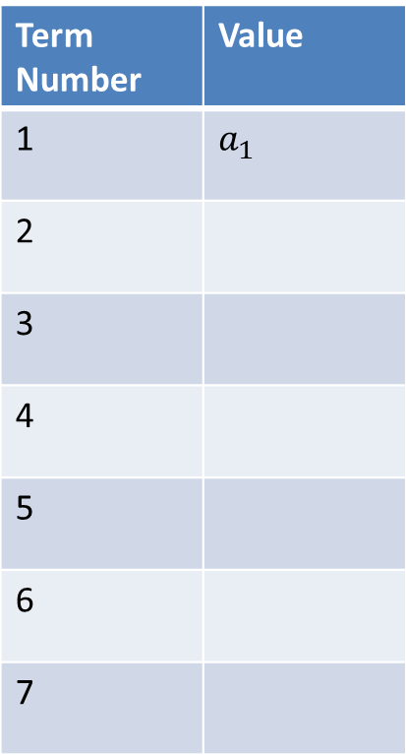
Writing a General Closed Form for a Geometric Sequence
Term Number | Value
1 | $a_{1}$
2
3
4
5
6
7

Slide 8
The Explicit Formula for a Geometric Sequence
The Explicit Formula for a Geometric Sequence is the same as the general closed form for a geometric sequence.
Using our sequence notation, the Explicit Formula for a Geometric Sequence is as follows:
$$a_{n}=a_{1}∙r^{n−1}$$
where R is the common ratio and n is the term number

Slide 9
Writing an Explicit Formula for a Geometric Sequence
You buy a car for $20,000 and each year the value of the car depreciates by 10%. Write an explicit formula for this situation and find the value of the car after 10 years.
Let’s Find the First Few Years
1: 20000-.1(20000)=18000
2: Year 1-.1(year 1)=18000-.1(18000)=16200
3: 16200-.1(16200)=14580
To find the common ratio, we do $\frac{Year 2}{Year 1} or \frac{year 3}{year 2}$ which gives is 0.9. So, in all reality, if we go down by 10%, we really multiply by 90% (which is the percent leftover). Our starting value is 20000
The formula will be: $a_{n}=20000{(.9)}^{n−1}$
We can find the price after ten years by using $a_{10}=20000{(.9)}^{10−1}=7748.41$
After ten years, the car will be worth $7748.41.

Slide 10
Formulas for Geometric Sequences
Recursive Formula:$a_{n}=a_{n−1}∙r where{ a}_{1}=b$
Explicit Formula: $a_{n}=a_{1}∙r^{n−1}$
What will be the common ratio be if you increase by 20% each year?
What will be the common ratio be if you decrease by 25% each year?
Why do we use $r^{n−1 } and not r^{n}$ in the explicit formula?

